Slide 1


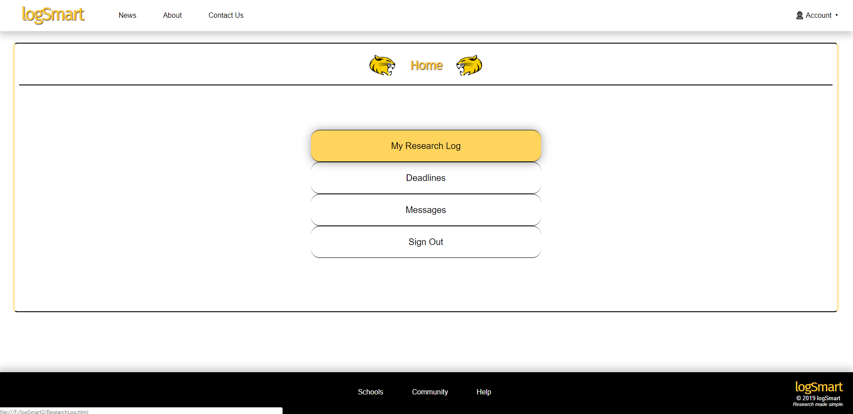

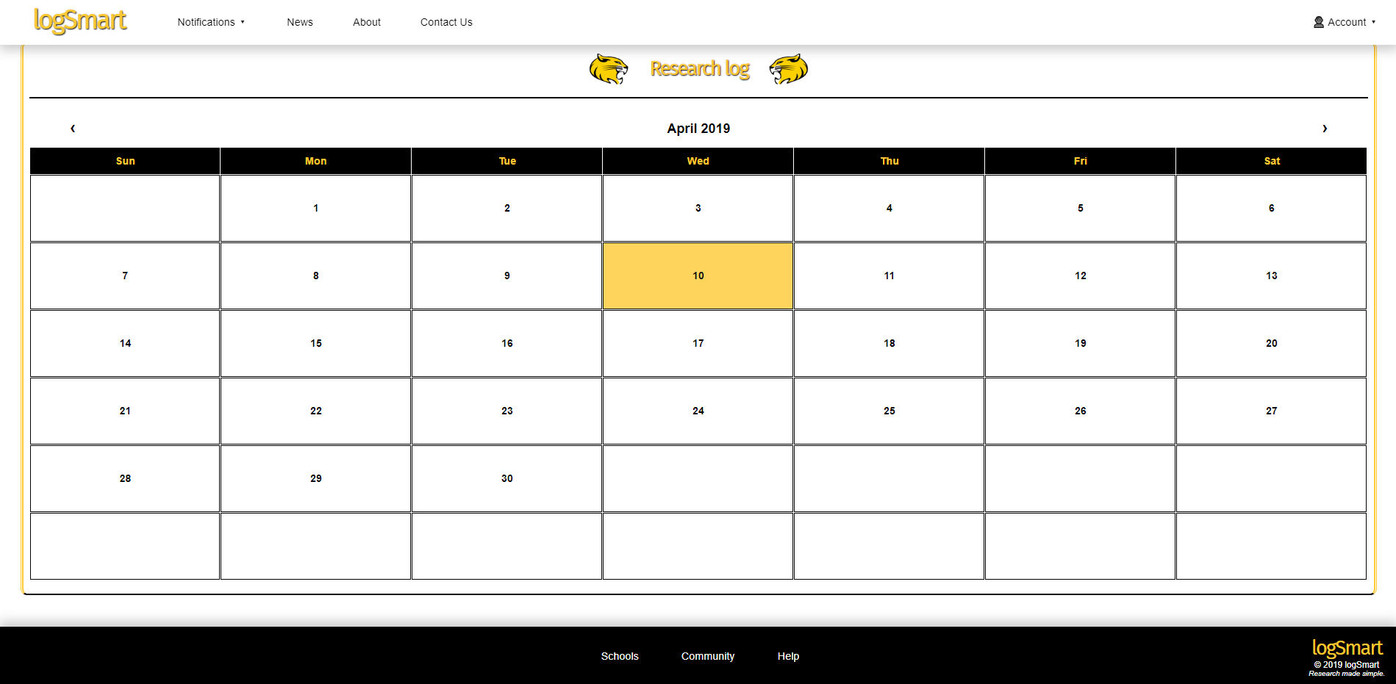
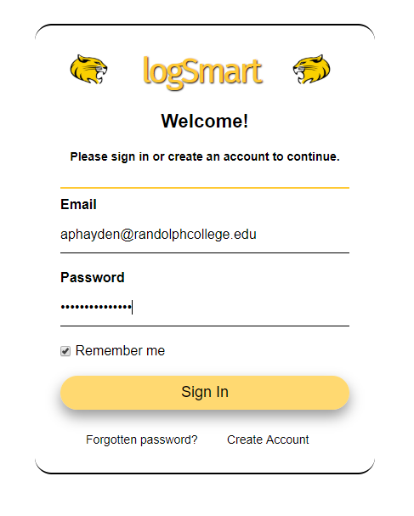
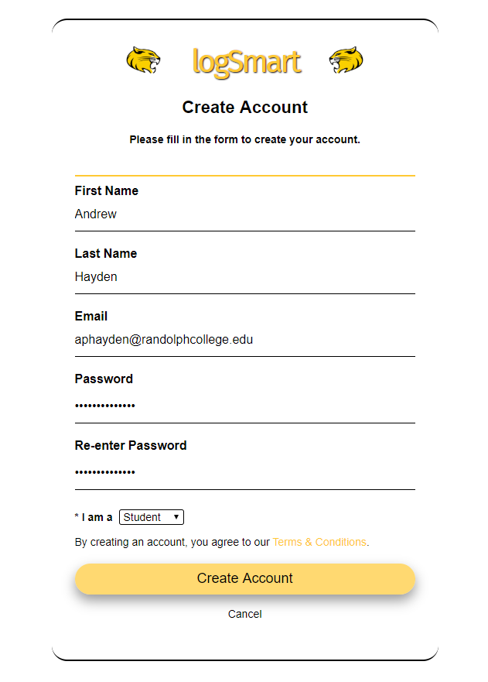


Creating a Digital Environment that Increases Research’s Accountability and Communication
Andrew Hayden, Emad Davis, and Mengjin Sun, supervised by Dr. Jia Wan, Class Project for CSCI 346
Motivation
Students and professors may have a difficult time keeping track of progress and communicating effectively while working on research. We found that the existing online classroom managers are not efficient in solving this problem because the broad functionalities they portray shift the focus to other areas. Therefore, we are aiming to build a specific and user friendly web application for research students and professors.
Outcomes
Our team has built and developed a fully functional front end of the website, logSmart. This website will bridge the gap of communication between research advisors and their advisees. As of right now, users can navigate through an array of different pages which include the login page, create account page, home page, research log page, and many more.
Why logSmart?
Specifically focuses on research and the communication between research advisors and their advisees
Simple, easy to use calendar that centralizes all of your research in one place
There is no unnecessary tabs, menus, or tools – everything will be used within the website
The sleek design makes it aesthetically pleasing
Open source project and completely free
Students
Use logSmart to
set up research projects and update the progress
Research Supervisors
FIGURE 1. Project Plan
FIGURE 3.
Home page
Developments On the Way
Database implementation
Refactoring and version management
Technology Package
The home page guides users to the calendar page, and research, profile, and developers information. The calendar page gives a clear view of the projects a user have. For specific projects, users can view, add, and modify messages and deadlines.
Front-End:
Browsers and other user interfaces
Acknowledgements
W3Schools – educational website for learning web technologies
Stack Overflow – question and answer site for programmers
GitHub – an open source development platform
CSS-Tricks – forum that contains unique tips for the CSS language
Rising Stack – full-stack software development agency
Sommerville, Software Engineering, 9th edition
Software Engineering Standards Committee of the IEEE Computer Society
Code Pen – an online community for project test and showcase
FIGURE 4.
Calendar page
Back-End:
Servers and Databases
FIGURE 2: Communication Process on the website
FIGURE 5.
Login page
FIGURE 6.
About Us Page

